Slide 1

FINANCE & FACILITIES COMMITTEE MEETING
OCTOBER 13, 2022

Slide 2

FINANCE & FACILITIES COMMITTEE MEETING
OCTOBER 13, 2022
Agenda Items
  CornerStone Cash Management Update - Kevin Karpuk
  Request for Two Long Term Substitute English Learner Staff
  Approve Bid #22-37
  Facilities Update – Doug Taylor

Slide 3
Request for Temporary English Language Development (ELD) Staff
May 2022
October 2022
Net Difference
283 EL Students
(33% Immigrants)*
353 EL Students
(48% Immigrants)
70 New EL Students
(15% increase in Immigrants)
* According to the Pennsylvania Department of Education, an immigrant is defined as a student from outside of the country and resident in the US for less than 3 years. Many have little or no English skills and are placed in regular classrooms and content area courses.

Slide 4
Request for Temporary English Language Development (ELD) Staff
Numbers are fluid and increasing.
Prior to last year, we added two (2) new ELD (English Language Development) Specialists, however that did not account for the +70 surge.
We have learned from our registration office that many families are “multiple occupancy and migratory.”

Slide 5
Request for Temporary English Language Development (ELD) Staff
Request:
  2.0 LTS (long-term substitute) ELD (English Language Development) Specialists
  Not permanent, but will meet emergent needs.
  Analyze mid-year and at end-of-year.

Slide 6
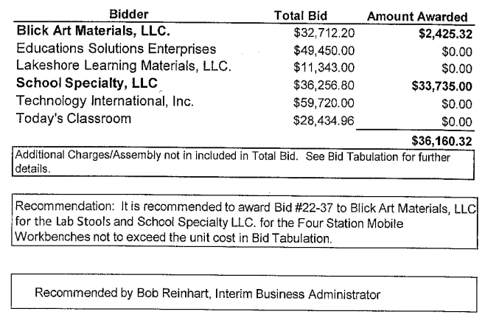
Approve Bid # 22-37
Approve Lab Stools and Four Station Mobile Workbenches Bid #22-37

Slide 7
QUESTIONS?

Slide 8
CASH MANAGEMENT UPDATE
October 2022
Kevin Karpuk, CFA
Chief Investment Officer

Slide 9
TREASURY YIELD CURVE
Source: US Department of the Treasury

Slide 10
SIX MONTH TREASURY
Source: US Department of the Treasury

Slide 11
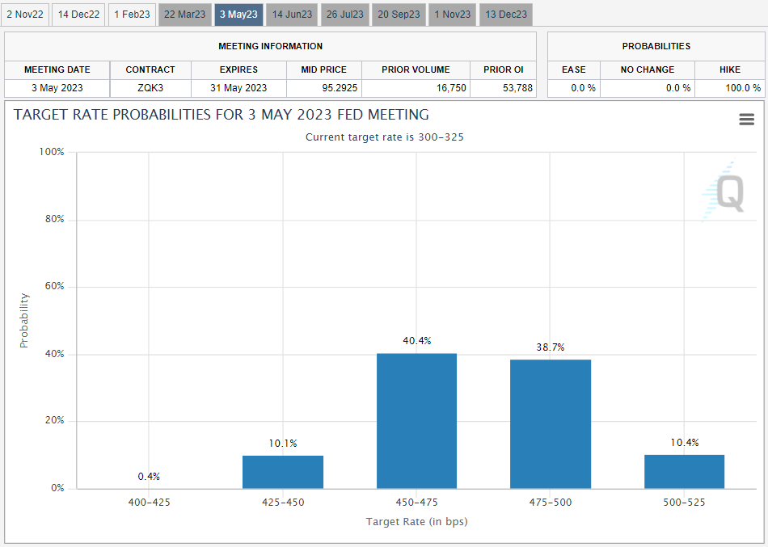
FUTURE RATES
Source: CME Group as of 10/10/2022
Notes:
https://www.cmegroup.com/trading/interest-rates/countdown-to-fomc.html

Slide 12
ASSET LOCATION
6/30/22-9/30/22
Manager - Mandate | Beginning Market Value | Income | Deposits | Transfers | Expenses | Withdrawals | Change in Market Value | Ending Market Value
M&T - Wilmington Trust Portfolio | $10,974,730 | $0.00 | $0 | $0 | ($2,195) | $0 | ($150,492) | $10,822,042
StoneCastle Portfolio | $10,018,305 | $38,106 | $0 | $0 | $0 | $0 | $0 | $10,056,411
TD - General Fund | $26,223,901 | $54,375 | $156,484,094 | $0 | $0 | ($69,718,506) | $0 | $113,043,864
PLGIT - General Fund | $45,039,040 | $246,973 | $21,929,580 | $0 | $0 | ($42,495) | $0 | $67,173,099
TD - CRSD Compensating Balance | $5,711,696 | $3,065 | $0 | $0 | $0 | $0 | $0 | $5,714,761
Total General Funds | $97,967,672 | $342,519 | $178,413,674 | $0 | ($2,195) | ($69,761,001) | ($150,492) | $206,810,178
TD - Capital Reserve | $5,079,906 | $6,443 | $0 | $0 | $0 | ($2,104,773) | $0 | $2,981,575
Total Capital Reserves | $5,079,906 | $6,443 | $0 | $0 | $0 | ($2,104,773) | $0 | $2,981,575
PLGIT - GO Bonds Series of 2021 | $9 | $0 | $0 | $0 | $0 | $0 | $0 | $9
PLGIT - GO Bonds Series of 2022 | $8,172,022 | $15,672 | $0 | ($7,000,000) | $0 | $0 | $0 | $1,187,694
PLGIT - 2012 Escrow - Northampton TWP - Holland Elem | $1,272,577 | $6,178 | $0 | $0 | $0 | $0 | $0 | $1,278,754
PLGIT - Escrow - Newtown Township | $101,234 | $491 | $0 | $0 | $0 | $0 | $0 | $101,726
PLGIT - Northampton TWP - Holland MS | $689,194 | $3,346 | $0 | $0 | $0 | $0 | $0 | $692,539
PLGIT - Newtown TWP - Newton MS | $359,857 | $1,747 | $0 | $0 | $0 | $0 | $0 | $361,604
PLGIT - Escrow - Rolling Hills Elementary | $1,298,557 | $6,304 | $0 | $0 | $0 | $0 | $0 | $1,304,861
PLGIT - Sol Feinstone Elementary - Escrow | $2,848,634 | $13,829 | $0 | $0 | $0 | $0 | $0 | $2,862,463
PLGIT - CR High School South Turf - Escrow | $1,555,934 | $7,553 | $0 | $0 | $0 | $0 | $0 | $1,563,487
PLGIT - Hillcrest Elementary - Escrow | $895,936 | $4,349 | $0 | $0 | $0 | $0 | $0 | $900,286
Total Bond Funds | $17,193,953 | $59,469 | $0 | ($7,000,000) | $0 | $0 | $0 | $10,253,422
TD - Capital Projects | $2,344,668 | $4,128 | $99,500 | $7,000,000 | $0 | ($7,639,401) | $0 | $1,808,895
FNBN - Cafeteria Account | $860,459 | $57 | $402,255 | $250,000 | $0 | ($831,596) | $0 | $681,175
PLGIT - Cafeteria Account | $1,731,644 | $7,456 | $156,071 | ($250,000) | $0 | $0 | $0 | $1,645,171
PLGIT - Scholarship Account | $23,039 | $105 | $0 | $0 | $0 | $0 | $0 | $23,144
PLGIT - Ellen Cohen Scholarship | $1,841 | $8 | $0 | $0 | $0 | $0 | $0 | $1,850
FNBN - Student Activities | $1,072,151 | $0 | $88,572 | $0 | $0 | ($217,472) | $0 | $943,252
Total Miscellaneous Funds | $6,033,802 | $11,754 | $746,398 | $7,000,000 | $0 | ($8,688,469) | $0 | $5,103,486
Aggregate Portfolio | $126,275,333 | $420,185 | $179,160,072 | $0 | ($2,195) | ($80,554,242) | ($150,492) | $225,148,661
General Fund FYTD Income | $348,962
Bond Fund FYTD Income | $59,469
Aggregate Relationship FYTD Income | $420,185

Slide 13
QUARTERLY PERFORMANCE
Data as of 6/30/2022

Slide 14
WILMINGTON TRUST
INVESTMENT SUMMARY
Coupon | Market Value | % of Portfolio
0.13% | $1,981,930 | 18.3%
0.17% | $954,289 | 8.8%
0.23% | $1,144,814 | 10.6%
0.27% | $983,211 | 9.1%
0.33% | $1,128,484 | 10.4%
0.40% | $3,654,635 | 33.8%
0.50% | $931,647 | 8.6%
N/A | $43,033 | 0.4%
 | $10,822,042 | 100%
Maturity Year | Market Value | % of Portfolio
2023 | $5,356,716 | 49.5%
2024 | $5,422,293 | 50.1%
N/A | $43,033 | 0.4%
 | $10,822,042 | 100.0%
Data as of 11/30/2021

Slide 15
WILMINGTON TRUST
HOLDINGS
Asset Description | Quantity | Cost | Market Value | Market Value + Accrued Income
FHLB 0.400% 5/24/24 | 1,500,000 | $1,500,000 | $1,400,940 | $1,403,057
FHLB 0.400% 6/28/24 | 1,060,000 | $1,057,668 | $986,192 | $987,288
FHLB 0.500% 7/12/24 | 1,000,000 | $1,000,000 | $930,550 | $931,647
FFCB 0.270% 10/05/23 | 1,025,000 | $1,024,231 | $981,858 | $983,211
FFCB 0.125% 5/03/23 | 1,035,000 | $1,034,224 | $1,009,580 | $1,010,112
FFCB 0.170% 11/03/23 | 1,000,000 | $999,500 | $953,590 | $954,289
FFCB 0.330% 4/05/24 | 1,200,000 | $1,198,500 | $1,126,548 | $1,128,484
FFCB 0.230% 11/13/23 | 1,200,000 | $1,199,100 | $1,143,756 | $1,144,814
FHLMC MTN 0.400% 6/30/23 | 1,300,000 | $1,300,000 | $1,262,976 | $1,264,290
U.S. TREASURY NOTES 0.125% 1/15/24 | 1,025,000 | $1,023,042 | $971,546 | $971,818
Wilmington US Treasury Money Mkt Sel | 42,954 | $42,954 | $42,954 | $43,033
Total: |  | $11,379,219 | $10,810,491 | $10,822,042
Holdings as of 8/31/2022

Slide 16
SHORT-TERM HOLDINGS
EXAMPLE
Asset Description | Quantity | Cost | Market Value | Market Value + Accrued Income
FFCB 0.270% 10/05/23 | 1,025,000 | $1,024,231 | $981,858 | $983,211
As interest rates increase the mark-to-market value of bonds goes down to even out the expected yield. For example:
1 Year yield from the Treasury Yield Slide = 4.1%
The yield on this bond (maturing in 1 year with a coupon of 0.27%) = 4.2%
This bond is backed by the federal government, so it will mature in 1 year at face value.
Holdings as of 8/31/2022

Slide 17
TD BANK
Effective March 24, 2020, TD has replaced the asset-backed securities historically used as collateral with a letter of credit backed by the Federal Home Loan Bank of Pittsburgh.

Slide 18
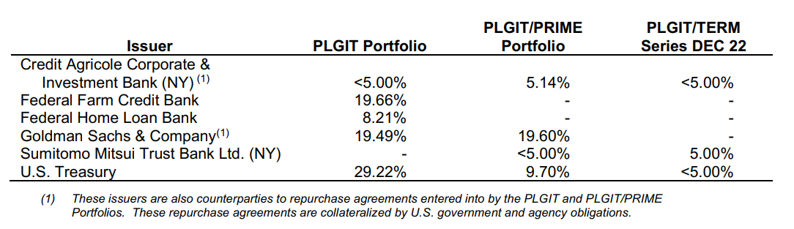
PLGIT ACCOUNT
Data as of 12/31/2021

Slide 20
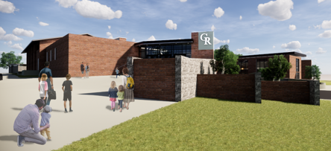


Council Rock School District
Finance Committee Meeting
October 13, 2022

Slide 21
FINANCE COMMITTEE MEETING
FACILITIES RELATED AGENDA ITEMS
Facilities Improvement Projects Update
  Sol Feinstone Elementary School Additions and Renovations Project
  Richboro Elementary School Additions and Renovations Project
II. Capital Improvement Plan Update (2022-2023 Version 1.11)
  Update on Delivery and Presentation of the New CIP Book and 5-Year Plan
II. Board Agenda Items (20OCT22 Mtg.)
  CRHS South Auditorium Lighting Project Bid Recommendation
  HCES and SFES Furniture Purchase
  HCES Change Order

Slide 22

FACILITIES IMPROVEMENT PROJECTS UPDATE

Slide 23


Sol Feinstone Elementary School
Additions and Renovations Project
Update

Slide 24
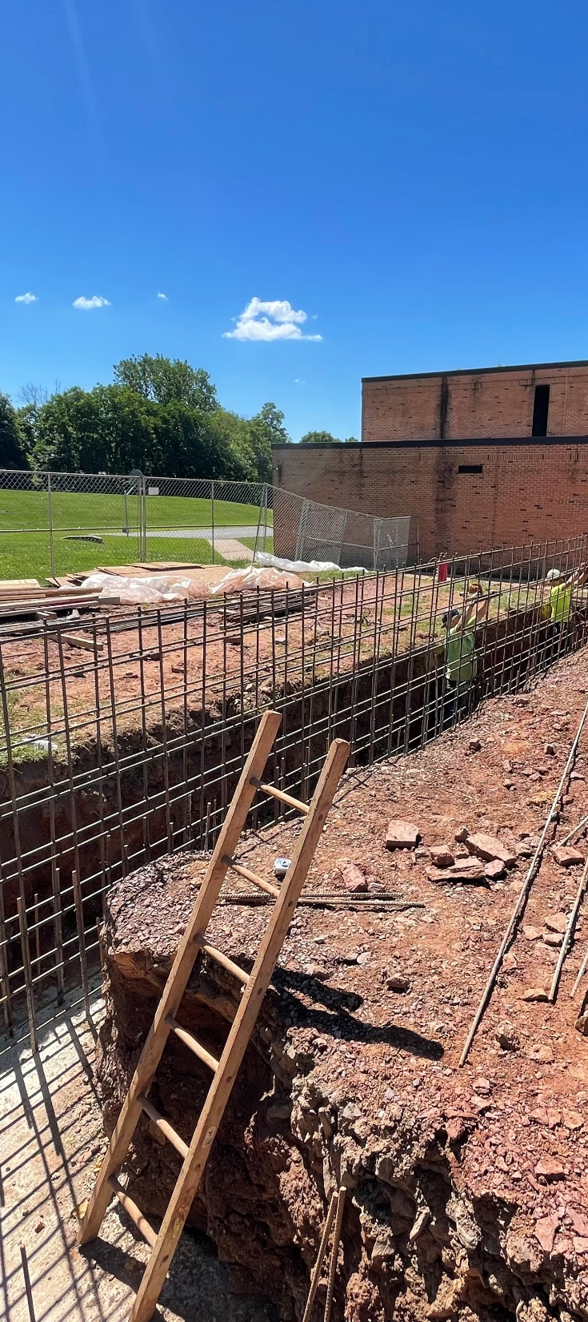
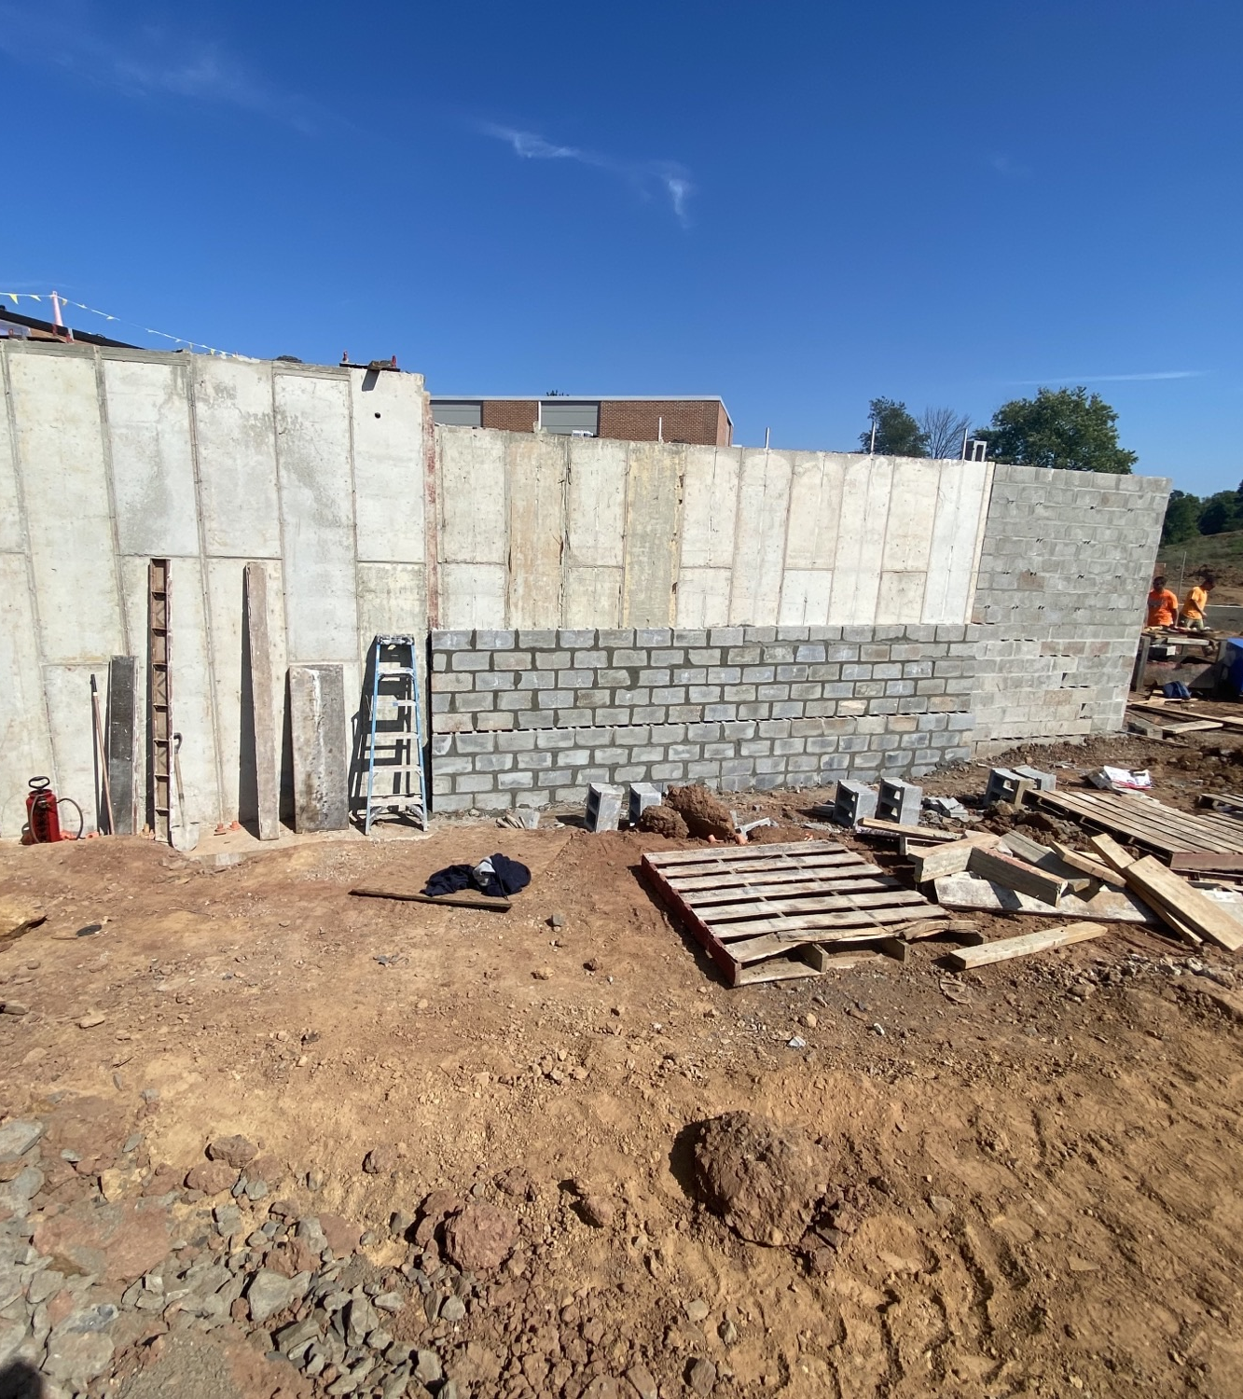

Sol Feinstone Elementary School – Add. and Reno. Project
New ADA Ramp Construction
New Student Entry and Kitchen Addition
Sol Feinstone ES Additions and Renovations Project
Progress Photos – New Entry/Cafeteria Construction

Slide 25
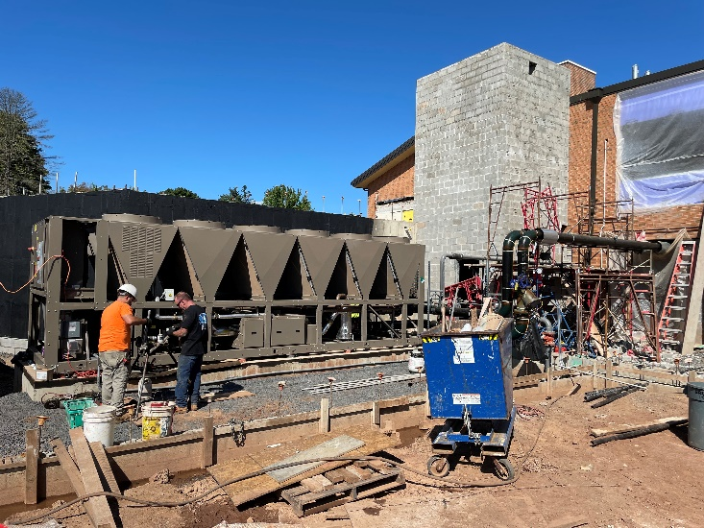
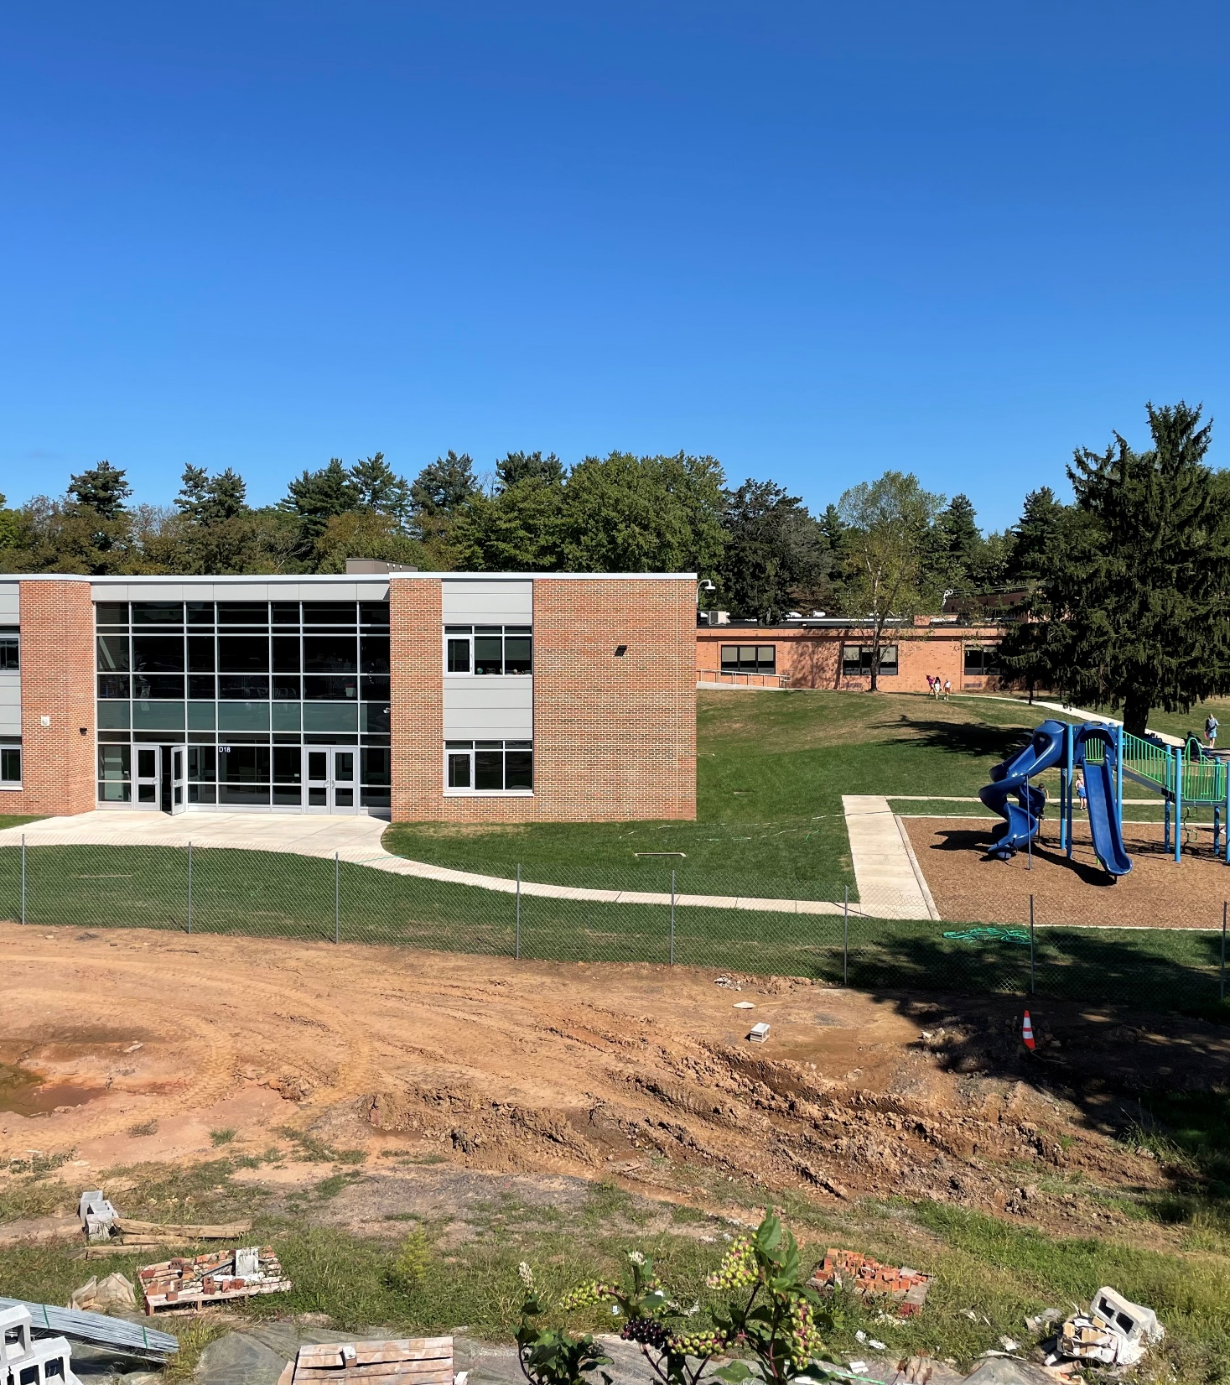
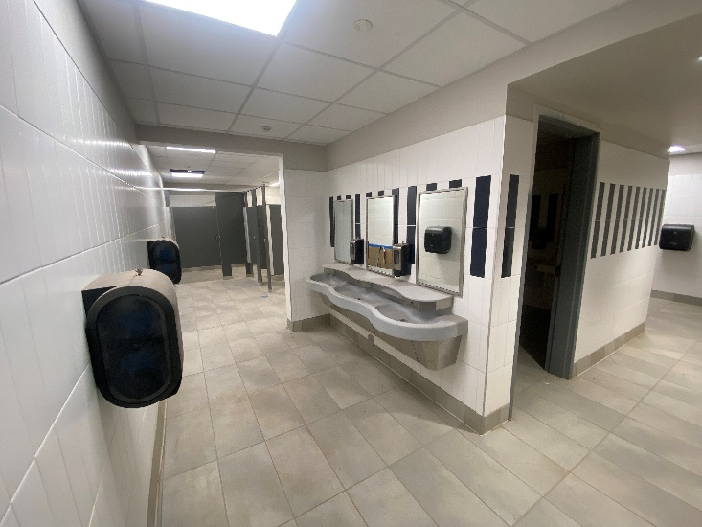
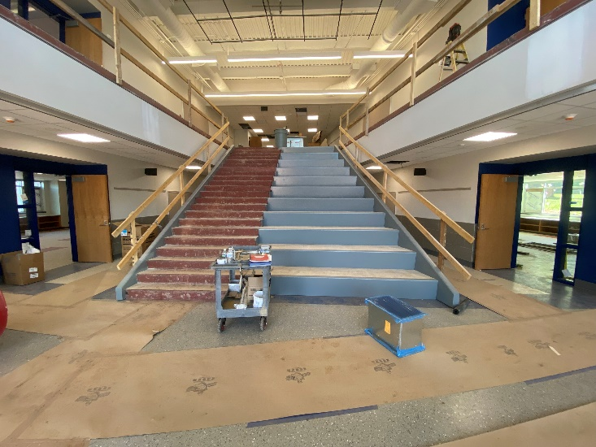
Sol Feinstone Elementary School – Add. and Reno. Project
New Air-Cooled Chiller New Toilet Rooms
New Learning Stairs New Classroom Addition
Sol Feinstone ES Additions and Renovations Project
Progress Photos – New ADA Ramp Construction

Slide 26
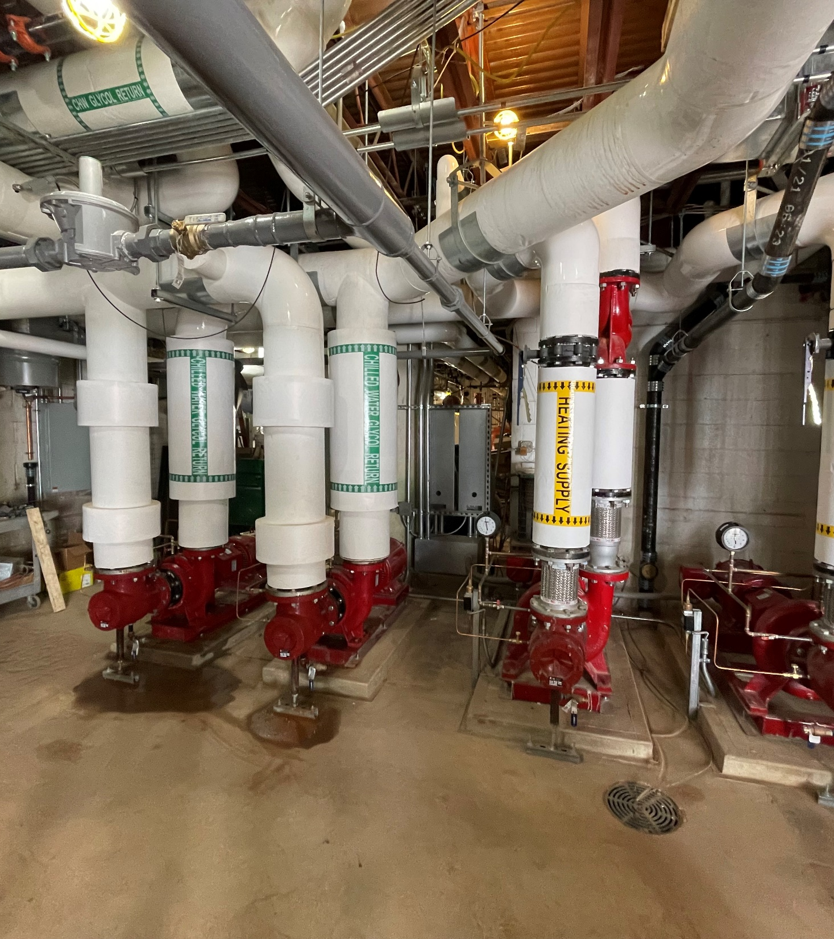
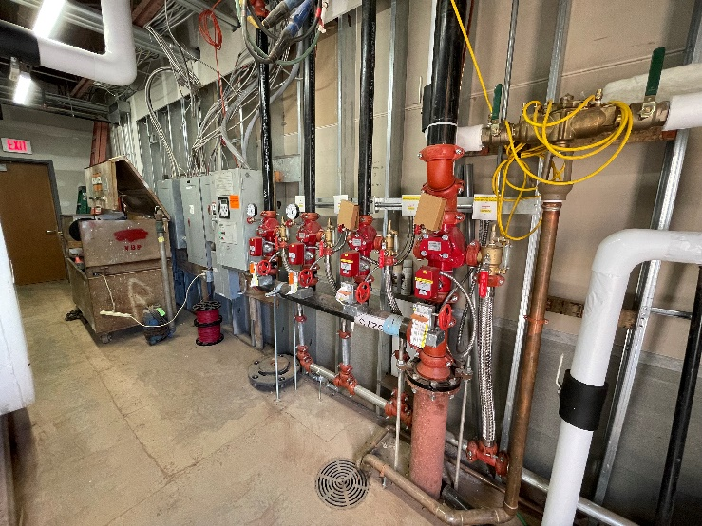
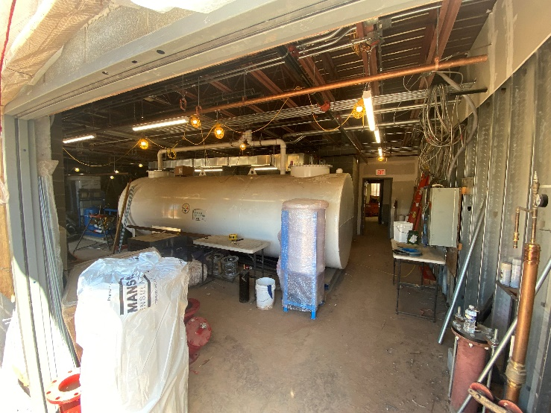
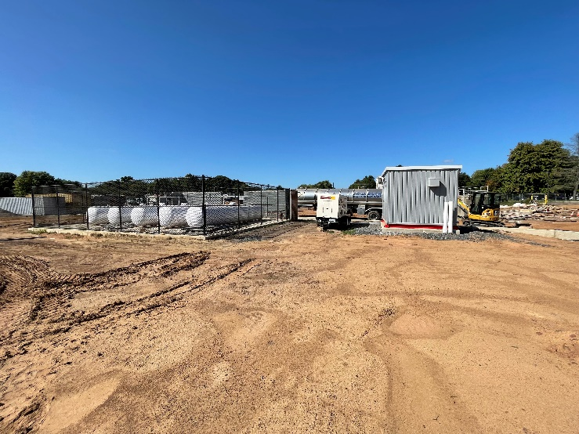
Sol Feinstone Elementary School – Add. and Reno. Project
New H/C Water Hydronic Piping New Fire Service Entry
New Domestic Water Storage Tank New Propane Energy
Sol Feinstone ES Additions and Renovations Project
Progress Photos – New ADA Ramp Construction

Slide 27
Richboro Elementary School
Additions and Renovations Project
Update

Slide 28

Richboro Elementary School Additions and Renovations Project
Project Schedule (Bolded Activities Require CR Attendance/Approvals/Action)
Preliminary Project Schedule (Updated 13OCT22)
Activity | Start Date | Finish Date
Schematic Design Phase | 11MAY22 | 29JUL22
Design Development | 01AUG22 | 28OCT22
Construction Documents | 31OCT22 | 27JAN23
Land Development - Utilities (Water/Sewer) | 13SEP22 | 24FEB23
Planning Commission Meeting (7:00PM) Approved | ----- | 13SEP22
Zoning Hearing Board Meeting (6:00PM) | ----- | 24OCT22
Review Design Development Docs at Finance Meeting |  | 10NOV22
Board of Supervisors Meeting (7:00PM) | ----- | 16NOV22
Board Approval of Act 34 Advertisement | ----- | 17NOV22
CRSD Advertise for Act 34 Hearing (20 Day Requirement) | 21NOV22 | 11DEC22
Act 34 Hearing – Prior to Finance Committee Meeting (6:30PM) | ----- | 15DEC22
Advertisement, Bidding and Contracts | 02JAN23 | 02FEB23
Review Bid Results – Finance Committee | ----- | 09FEB23
Board Approval of Bids - Contracts | ----- | 16FEB23
Notice to Proceed – Submittals, Order Materials | ----- | 20FEB23
CRSD Moves RES to Former Richboro Middle School | 19JUN23 | 30JUN23
Construction Phase (18 Months) | 04JUL23 | 01DEC24

Slide 29

Capital Improvement
Plan Update

Slide 30
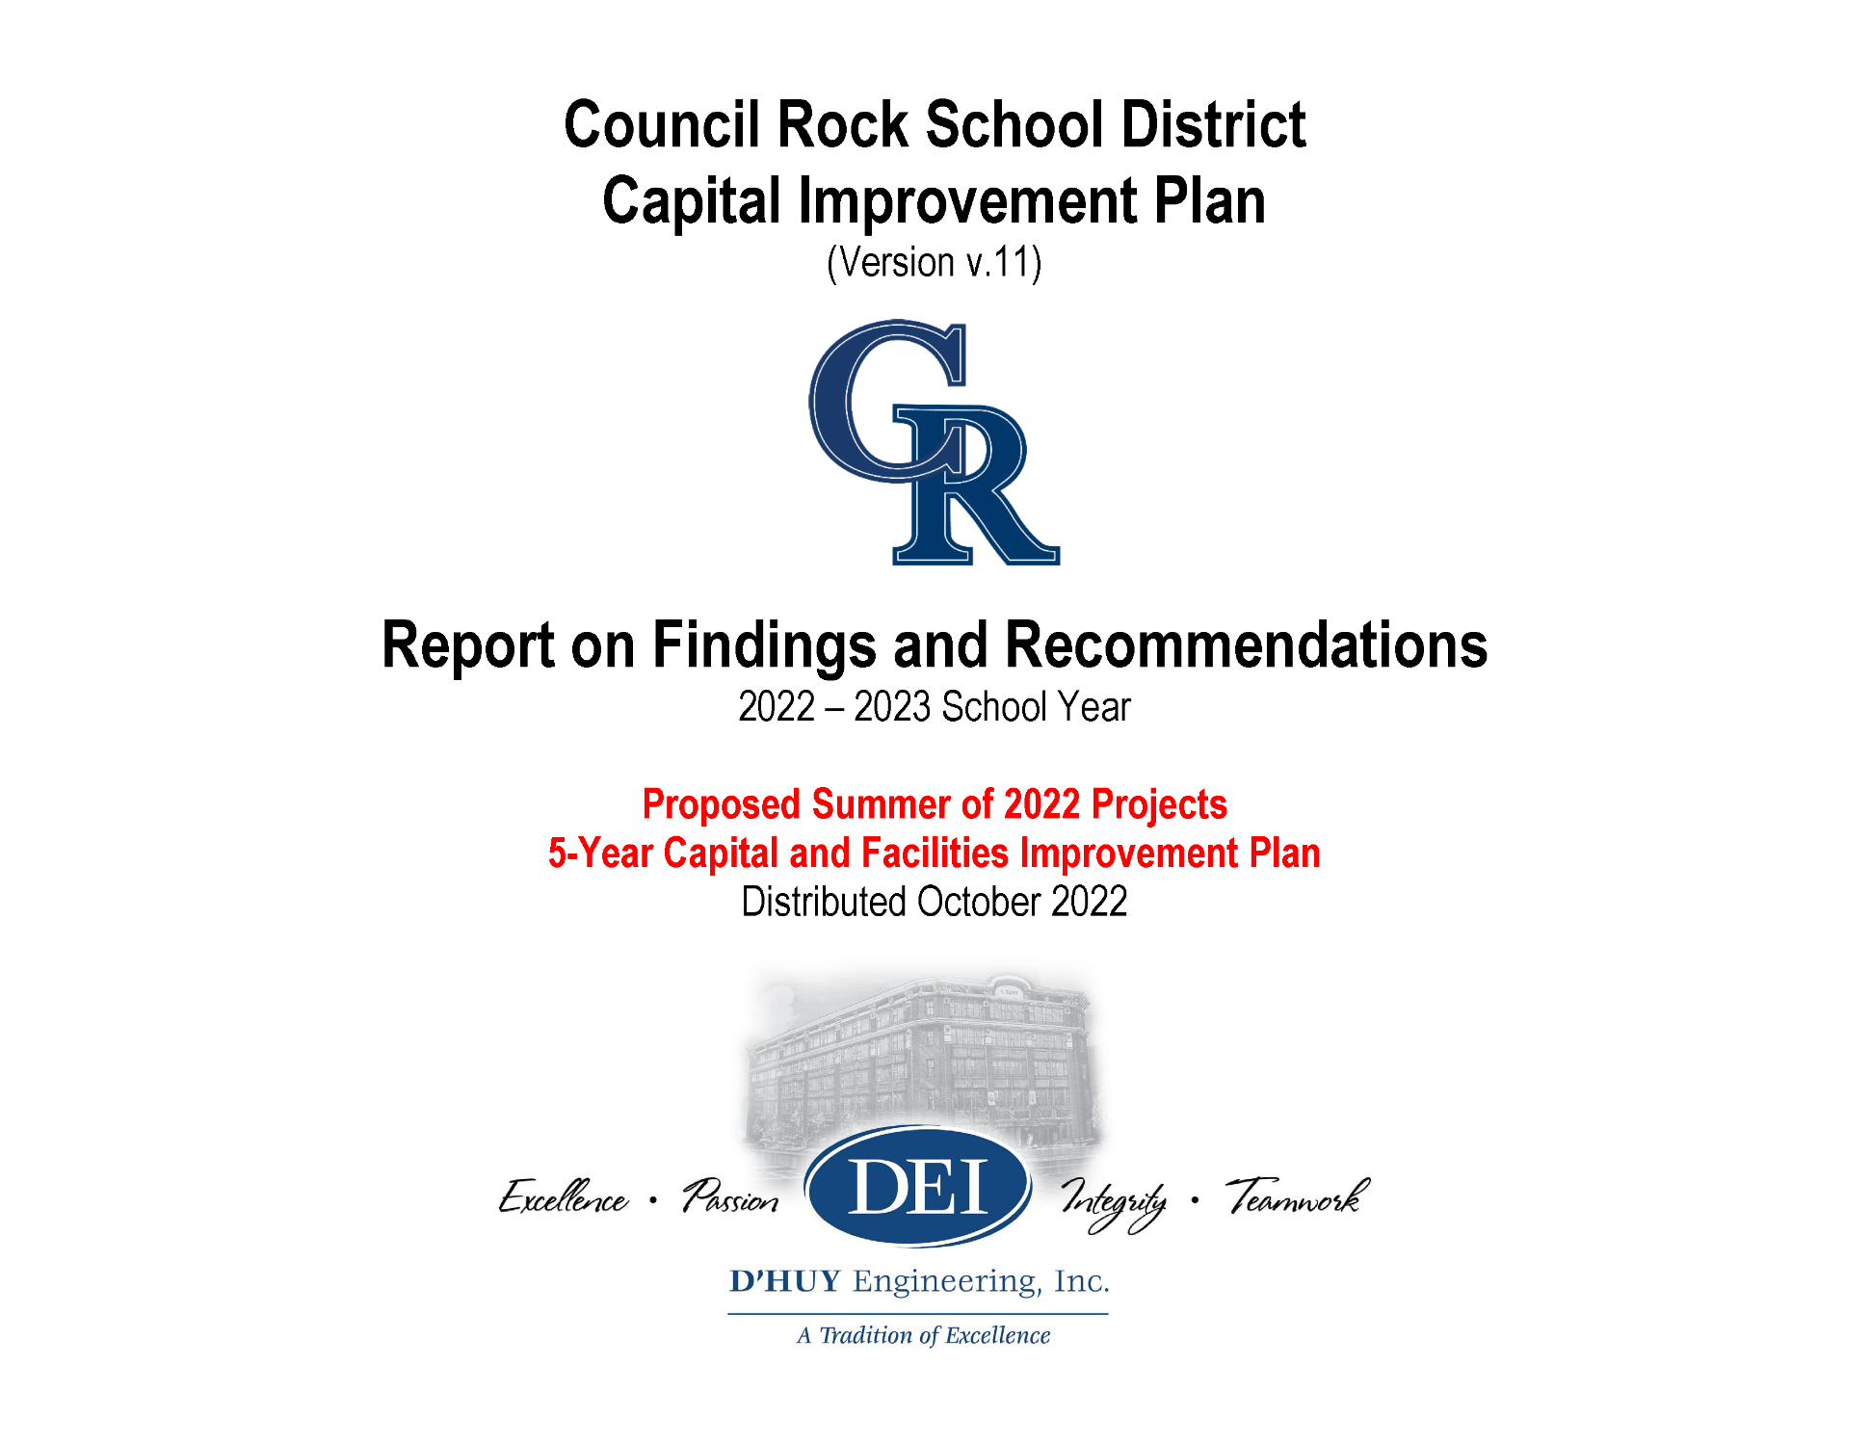

Council Rock School District
2022-2023 Capital Improvements Plan
Progress Update
The CIP Books will be delivered to the CRSD for distribution by 31OCT22
The CIP Update will be reviewed at the 10NOV22 Finance Committee Meeting
D’Huy Engineering will request approval to commence with the 2023 CIP Projects
Focus on projects without long lead items
Consideration to commence with CC HVAC design now to assure delivery of equipment for 2024/2025 start.

Slide 31
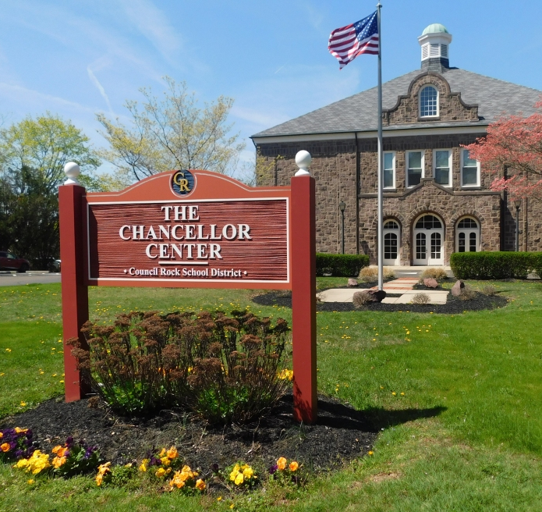
BOARD AGENDA ITEMS
20OCT22

Slide 32
Board Agenda Items (20OCT22)
CRHS South Auditorium Lighting Bid Results
The Summary of Bids is as Follows:
Budget: $750,000
CRHS SOUTH AUDITORIUM LIGHTING
 | A.N. Lynch Co | Cedar Electric | MJF Electric | Philips Bros
BASE BID | No Bid | $2,347,000 | No Bid | No Bid
Alternate No. 1: Add Replacement of Wood Stage Floor | No Bid | $72,000 | No Bid | No Bid
Alternate No. 2: Add all Work Associated with Electric 4 (Additional Light Bar) | No Bid | $12,700 | No Bid | No Bid
TOTALS | No Bid | $2,347,000 | No Bid | No Bid

Slide 33
Board Agenda Items (20OCT22)
CRHS South Auditorium Lighting Bid Results
Value Engineering/Cost Reduction Alternatives:
Description:
Savings:
Remove conduit requirement from Cabinet Remote Drivers to Type A Fixture Heads and provide a typical 16/2 Plenum Rated Cable
Allow alternate Theatrical Contractors, ParLights, Inc., Pittsburgh Stage, etc.
No new carpet or floor lighting (May need to add retro costs to existing step lighting to new dimmer racks)
Light fixtures changed to standard colors and no spares
Reuse existing power and replace fixtures only (optional design)
TOTAL ESTIMATED REDUCTIONS
($100,000)
($60,000)
($127,000)
($25,000)
($TBD)
($312,000)

Slide 34
Board Agenda Items (20OCT22)
CRHS South Auditorium Lighting Bid Results
Recommendation:
Reject bid and schedule meeting with South Admin/End Users to perform only needed repairs to house lights. Discuss the results, reasons, and alternative design options
Reasons for high bid
  combined scope of stage and house lighting
  effort to improve stage lighting design
  timing, economy
  limited competition
  physical height of auditorium structure (approximately 12’ from acoustical clouds to underside of structure)
  need to remove seating and acoustical clouds to access work area above
Rebid repairs project and exclude other work or include a series of alternate bid items
Recommendation to Reject the bid will be included on the board agenda

Slide 35
Board Agenda Items (20OCT22)
Richboro and Sol Feinstone ES Furniture
Hillcrest Elementary School Furniture – Additional
Select furniture was excluded from the construction bid
Library furniture by PEMCO includes: Work Tables and Computer Tables
Additionally, STEAM Classroom Activity Tables
Additionally, Library Soft Seating
Includes delivery and set-up
Cost included in the project budget – COSTARS 025-E22-157
PEMCO Educational and Contract Furniture – Total Cost: $27,252.41
Sol Feinstone Elementary School Furniture – Phase 2
Phase 2 furnishings, ongoing approvals by phase through 2024
Kindergarten and First Grade Furniture
Includes: Student Desks, Chairs, Teachers Desks, Chairs
Cost included in the project budget
PEMCO Educational and Contract Furniture – Total Cost: $54,792.70

Slide 36
Board Agenda Items (20OCT22)
Hillcrest ES Change Order
Hillcrest Elementary School Change Order GC-CO-02
The Construction Contract includes an asphalt escalation formula
Because petroleum pricing is so volatile, the index allows for fair pricing for all parties
The costs are based on actual quantities based on slips from the quarry
The cost will be addressed through the project contingency
Penn Builders, Inc. – Total Cost: $17,992.17

Slide 37

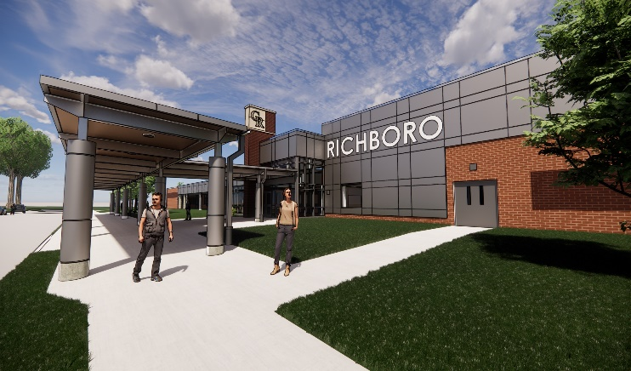
Thank you!

